Slide 1
Geometrija v prostoru
Piramida - vaje

Slide 2
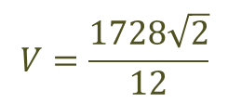
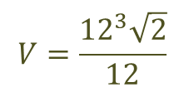
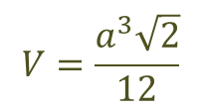
Izračunaj površino in prostornino tetraedra z osnovnim robom 12cm.
$$a=12 cm$$
$$P=a^{2}\sqrt{3}$$
$$V=\frac{a^{3}\sqrt{2}}{12}$$
$$P={12}^{2}\sqrt{3}$$
$$V=\frac{{12}^{3}\sqrt{2}}{12}$$
$$P=144\sqrt{3} {cm}^{2}$$
$$V=\frac{1728\sqrt{2}}{12}$$
$V=144\sqrt{2} {cm}^{3}$

Slide 3
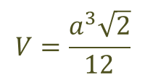
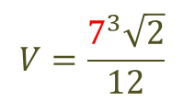
Natančno izračunaj prostornino tetraedra s površino $49\sqrt{3} m^{2}.$
$$P=49\sqrt{3} m^{2}$$
$$V=\frac{a^{3}\sqrt{2}}{12}$$
$$P=a^{2}\sqrt{3}$$
$$V=\frac{7^{3}\sqrt{2}}{12}$$
$$49\sqrt{3}=a^{2}\sqrt{3}$$
$$49=a^{2}$$
$$V=40,4 {cm}^{3}$$
$$7 cm=a$$

Slide 4
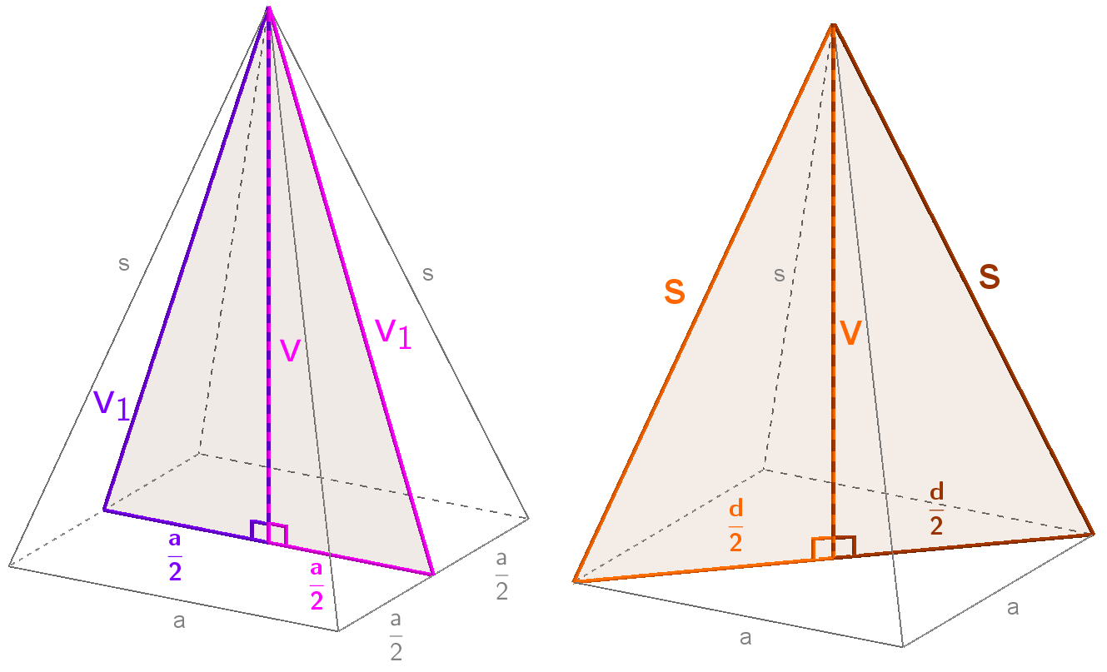
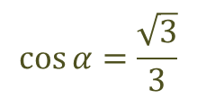
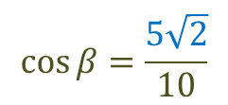
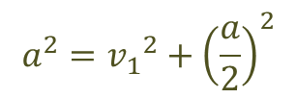
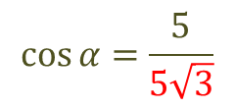
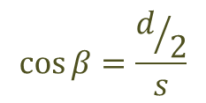
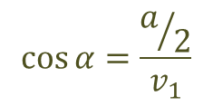
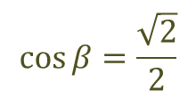
Dana je enakoroba štiristrana piramida z robom 10 cm. Izračunaj kot med telesno višino in višino stranske ploskve ter kot med stransko in osnovno ploskvijo in kot med stranskim robom in osnovno ploskvijo.
$$\cos{α=\frac{a/2}{v_{1}}}$$
$$\cos{β=\frac{d/2}{s}}$$
s = a
$$φ$$
$$\cos{α=\frac{5}{5\sqrt{3}}}$$
$$\cos{β=\frac{5\sqrt{2}}{10}}$$
$$α$$
$$β$$
$$\cos{α=\frac{\sqrt{3}}{3}}$$
$$\cos{β=\frac{\sqrt{2}}{2}}$$
$$α=54,7°$$
$$β=45°$$
$$a^{2}={v_{1}}^{2}+{\left(\frac{a}{2}\right)}^{2}$$
$$d^{2}=a^{2}+a^{2}$$
$${10}^{2}={v_{1}}^{2}+5^{2}$$
$$d^{2}={10}^{2}+{10}^{2}$$
$$φ=90°−54,7°=35,3°$$
$${10}^{2}−5^{2}={v_{1}}^{2}$$
$$d^{2}=200$$
$$75={v_{1}}^{2}$$
$$v_{1}=5\sqrt{3} cm$$
$$d=10\sqrt{2}cm$$

Slide 5
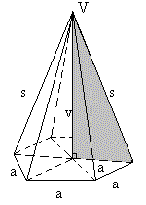
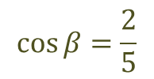
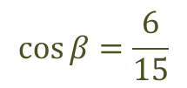
Osnovna ploskev piramide je pravilni šestkotnik. Izračunaj kot med stranskim robom in osnovno ploskvijo, če meri osnovni rob 6 cm in stranski 15 cm.
$$\cos{β=\frac{a}{s}}$$
$$\cos{β=\frac{6}{15}}$$
$$α$$
$$\cos{β=\frac{2}{5}}$$
$$β=66,4°$$

Slide 6
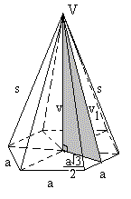
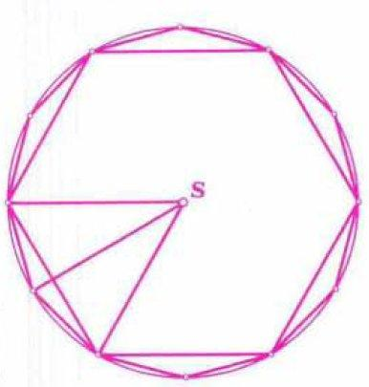
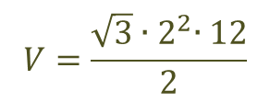
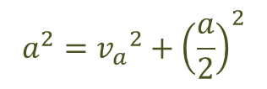
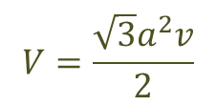
Izračunaj prostornino in površino 12 m visoke piramide, ki ima za osnovno ploskev krogu s polmerom 2 m včrtan šestkotnik.
$$P=\frac{3\sqrt{3}a^{2}}{2}+3av_{1}$$
$$V=\frac{\sqrt{3}a^{2}v}{2}$$
$$v=12m$$
$$a=2 m$$
$$P=\frac{3\sqrt{3}{∙2}^{2}}{2}+3∙2∙7\sqrt{3}$$
$$V=\frac{\sqrt{3}{∙2}^{2}∙12}{2}$$
$$P=48\sqrt{3} m^{2}$$
$$V=24\sqrt{3} m^{3}$$
$$a^{2}={v_{a}}^{2}+{\left(\frac{a}{2}\right)}^{2}$$
$${v_{1}}^{2}={v_{a}}^{2}+v^{2}$$
$$a^{2}−{\left(\frac{a}{2}\right)}^{2}={v_{a}}^{2}$$
$${v_{1}}^{2}={\sqrt{3}}^{2}+{12}^{2}$$
$$2^{2}−{\left(1\right)}^{2}={v_{a}}^{2}$$
$${v_{1}}^{2}=147$$
$$3={v_{a}}^{2}$$
R = a
$$\sqrt{3} m=v_{a}$$
$$v_{1}=7\sqrt{3} m$$

Slide 7
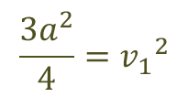
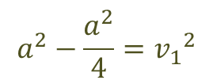
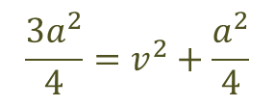
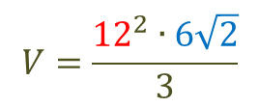
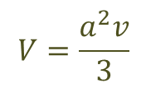
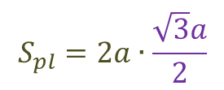
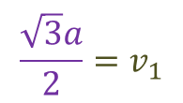
Pri pravilni enakorobi štiristrani piramidi je plašč $144\sqrt{3} {cm}^{2}$. Izračunaj dolžino roba in prostornino.
$$S_{pl}=144\sqrt{3} {cm}^{2}$$
$$S_{pl}=2av_{1}$$
s = a
$$S_{pl}=2a∙\frac{\sqrt{3}a}{2}$$
$$V=\frac{a^{2}v}{3}$$
$$V=\frac{{12}^{2}∙6\sqrt{2}}{3}$$
$$S_{pl}=\sqrt{3}a^{2}$$
$$144\sqrt{3}=\sqrt{3}a^{2}$$
$$a^{2}={v_{1}}^{2}+{\left(\frac{a}{2}\right)}^{2}$$
$${v_{1}}^{2}=v^{2}+{\left(\frac{a}{2}\right)}^{2}$$
$V=288\sqrt{2} {cm}^{3}$
$$a^{2}−\frac{a^{2}}{4}={v_{1}}^{2}$$
$$144=a^{2}$$
$$\frac{3a^{2}}{4}=v^{2}+\frac{a^{2}}{4}$$
$$12 cm=a$$
$$\frac{3a^{2}}{4}={v_{1}}^{2}$$
$$\frac{3∙{12}^{2}}{4}−\frac{{12}^{2}}{4}=v^{2}$$
$$\frac{\sqrt{3}a}{2}=v_{1}$$
$$v=6\sqrt{2} m$$

Slide 8
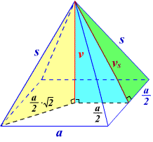
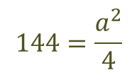
Koliko odstotkov površine predstavlja plašč pri pravilni štiristrani piramidi, ki ima višino 35 cm in stransko višino 37 cm?
$${v_{1}}^{2}={\left(\frac{a}{2}\right)}^{2}+v^{2}$$
$$v=35 cm$$
$$P=a^{2}+2av_{1}$$
$$v_{1}=37 cm$$
$$P={24}^{2}+2∙24∙37$$
$${37}^{2}={\left(\frac{a}{2}\right)}^{2}+{35}^{2}$$
$$P=2352 {cm}^{2}$$
$$1369−1225=\frac{a^{2}}{4}$$
$$S_{pl}=2av_{a}$$
$$144=\frac{a^{2}}{4}$$
$$S_{pl}=2∙24∙37$$
$$12=\frac{a}{2}$$
$$S_{pl}=1776 {cm}^{2}$$
$$24 cm=a$$
$$p=\frac{S_{pl}}{S}∙100=\frac{1776}{2352}∙100=75,5\%$$

Slide 9
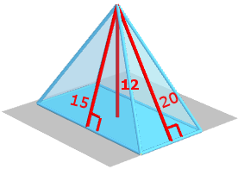
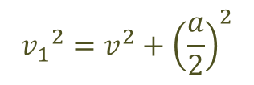
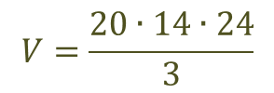
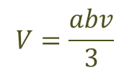
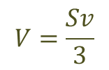
Pokončna štiristrana piramida ima za osnovno ploskev pravokotnik s stranicama 20 cm in 14 cm. Višina te piramide meri 24 cm. Izračunaj prostornino in površino te piramide.
$$a=20 cm$$
$$V=\frac{Sv}{3}$$
$${v_{1}}^{2}=v^{2}+{\left(\frac{a}{2}\right)}^{2}$$
$$b=14 cm$$
$$v$$
$$V=\frac{abv}{3}$$
$$v_{2}$$
$$v_{1}$$
$$v=24 cm$$
$${v_{1}}^{2}={24}^{2}+{10}^{2}$$
a
b
$$V=\frac{20∙14∙24}{3}$$
$$v_{1}=26 cm$$
$$V=2240 {cm}^{3}$$
$$P=S+S_{pl}$$
$${v_{2}}^{2}=v^{2}+{\left(\frac{b}{2}\right)}^{2}$$
$$P=ab+2∙\frac{av_{2}}{2}+2∙\frac{bv_{1}}{2}$$
$${v_{2}}^{2}={24}^{2}+7^{2}$$
$$P=ab+av_{2}+bv_{1}$$
$$v_{2}=25 cm$$
$$P=20∙14+20∙25+14∙26$$
$$P=1144 {cm}^{2}$$

Slide 10
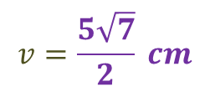
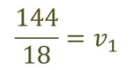
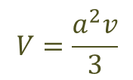
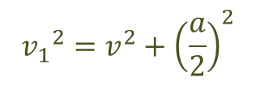
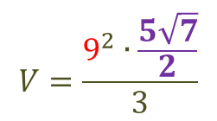
V pravilni štiristrani piramidi meri ploščina osnovne ploskve 81 ${cm}^{2}$ in plašč 144 ${cm}^{2}$. Izračunaj prostornino piramide.
$$V=\frac{a^{2}v}{3}$$
$$S=81 {cm}^{2}$$
$$S=a^{2}$$
$$S_{pl}=144 {cm}^{2}$$
$$V=\frac{9^{2}∙\frac{5\sqrt{7}}{2}}{3}$$
$$81=a^{2}$$
$$9 cm=a$$
$$V=178,6 {cm}^{3}$$
$${v_{1}}^{2}=v^{2}+{\left(\frac{a}{2}\right)}^{2}$$
$$S_{pl}=2av_{1}$$
$${v_{1}}^{2}−{{\left(\frac{a}{2}\right)}^{2}=v}^{2}$$
$$144=2∙9∙v_{1}$$
$$\frac{144}{18}=v_{1}$$
$$8^{2}−{{\left(4,5\right)}^{2}=v}^{2}$$
$$v=\frac{5\sqrt{7}}{2} cm$$
$$8 cm=v_{1}$$

Slide 11
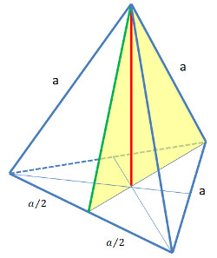
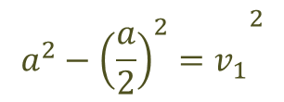
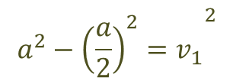
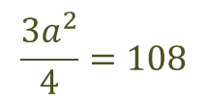
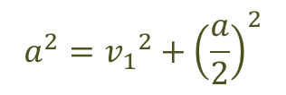
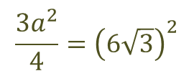
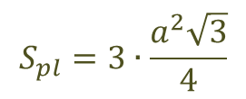
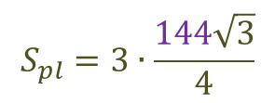
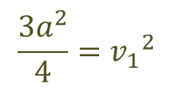
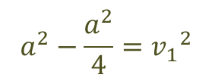
Stranska višina tetraedra je $6\sqrt{3}$ $cm$. Izračunaj plašč.
$$v_{1}=6\sqrt{3} cm$$
$$S_{pl}=3∙\frac{a^{2}\sqrt{3}}{4}$$
$$a^{2}={v_{1}}^{2}+{\left(\frac{a}{2}\right)}^{2}$$
$$a^{2}−{{{\left(\frac{a}{2}\right)}^{2}=v}_{1}}^{2}$$
$$S_{pl}=3∙\frac{144\sqrt{3}}{4}$$
$$a^{2}−{{{\left(\frac{a}{2}\right)}^{2}=v}_{1}}^{2}$$
$$S_{pl}=108\sqrt{3} {cm}^{2}$$
$$a^{2}−\frac{a^{2}}{4}={v_{1}}^{2}$$
$$\frac{{3a}^{2}}{4}={v_{1}}^{2}$$
$$\frac{{3a}^{2}}{4}=108$$
$$\frac{{3a}^{2}}{4}={\left(6\sqrt{3}\right)}^{2}$$
$$3a^{2}=432$$
$$a^{2}=144$$

